Slide 1




PRESENTATION ON BANK ANALYTICS (LOAN DATA) GROUP 5 By: Payal Yeole Pratiksha Jadhav Abdelrahman Khalid Shabnam Prashanth

Slide 2


Bank analytics is the systematic analysis of banking data—such as transactions, customer behavior, financial performance, and market trends—to extract actionable insights. These insights are used to support decision-making across various banking functions.

Slide 3

Q1) TOTAL LOAN AMOUNT FUNDED
Measures the total value of loans disbursed. Indicates the bank's lending capacity and market outreach.

Slide 4

Q2) TOTAL LOANS
Tracks the number of loans issued.

Slide 5

Q3) TOTAL COLLECTION
Reflects repayment performance, including principal and interest.

Slide 6

Q4)TOTAL INTEREST
Captures revenue from loan interest.

Slide 7
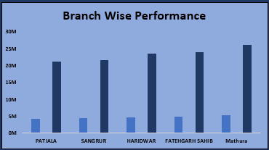
Q5) BRANCH-WISE PERFORMANCE
Analyzes revenue (interest, fees, total) by branch.

Slide 8
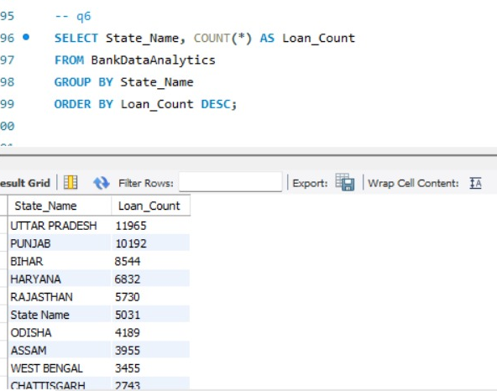
Q6) STATE-WISE LOAN
Shows geographic distribution of loans.

Slide 9
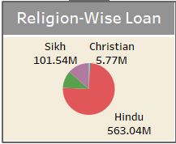
Q7) RELIGION-WISE LOAN
Monitors loan distribution across religious demographics.

Slide 10
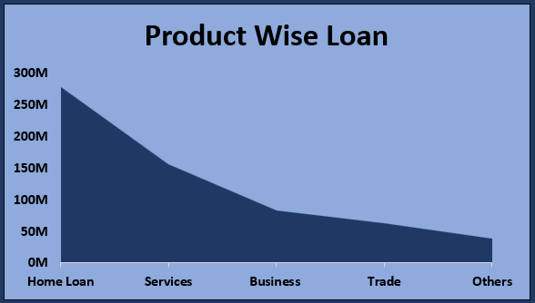
Q8) PRODUCT GROUP WISE LOAN
BRITA TAMM
502-555-0152
brita@firstupconsultants.com
www.firstupconsultants.com
Categorizes loans by product types (e.g., personal, auto).

Slide 11
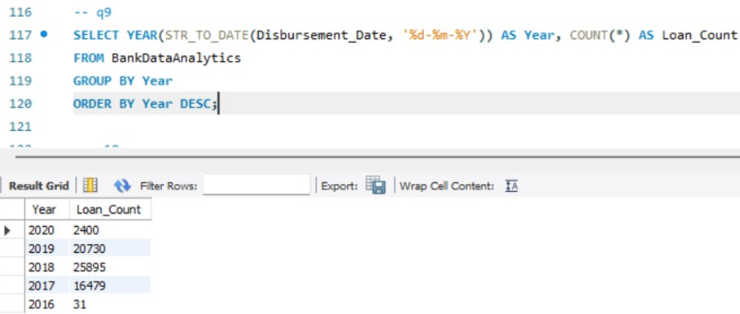
Q9) DISBURSMENT TREND
Tracks changes in loan disbursements over time.

Slide 12
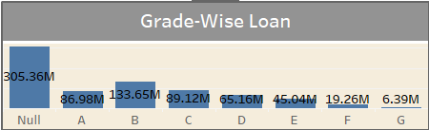
Q10) GRADE-WISE LOAN
Assesses portfolio risk by borrower credit grades.

Slide 13
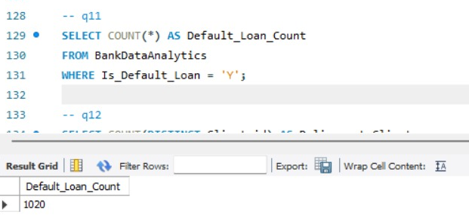
Q11) DEFAULT-LOAN COUNT
Counts loans in default.

Slide 14
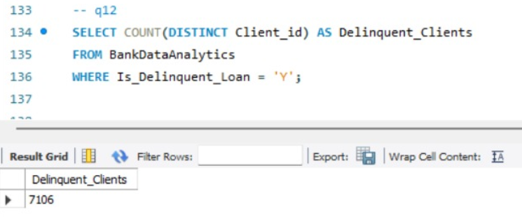
Q12) DELINQUENT CLIENT COUNT
Tracks borrowers with missed payments.

Slide 15
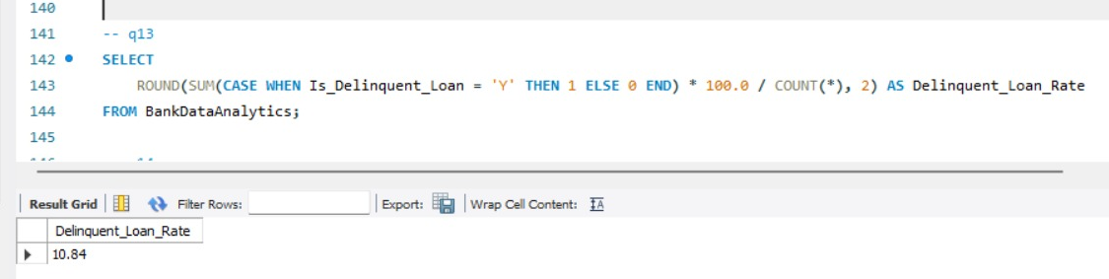
Q13) DELINQUENT LOAN RATE
Percentage of loans overdue in the portfolio.

Slide 16

Q14) DEFAULT LOAN RATE
Proportion of defaulted loans to the total portfolio.

Slide 17
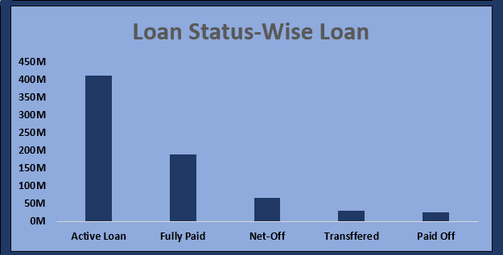
Q15) LOAN STATUS-WISE LOAN
Breaks down loans by status (active, delinquent, closed).

Slide 18
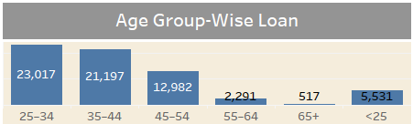
Q16) AGE GROUP-WISE LOAN
Categorizes loans by borrowers’ age groups.

Slide 19
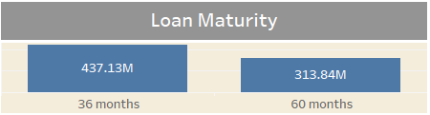
Q17) LOAN MATURITY
Tracks the timeline until full repayment

Slide 20
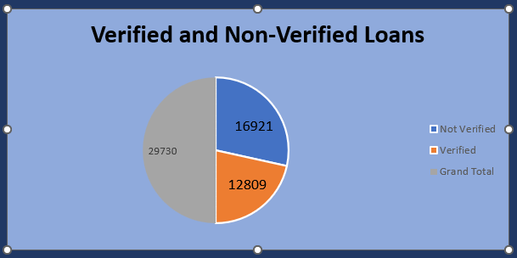
Q18) NO VERIFIED LOANS
Identifies loans without proper verification

Slide 21
Loan data analytics plays a vital role in managing risk, understanding customer segments, and enhancing banking operations. These insights empower banks to make informed decisions and ensure sustainable growth.

Slide 22


